Slide 1

Parameterised Modelling of Antenna Beams for Global 21cm Experiments
Dominic Anstey | 5th Global 21cm Workshop
On behalf of the REACH collaboration

Slide 2
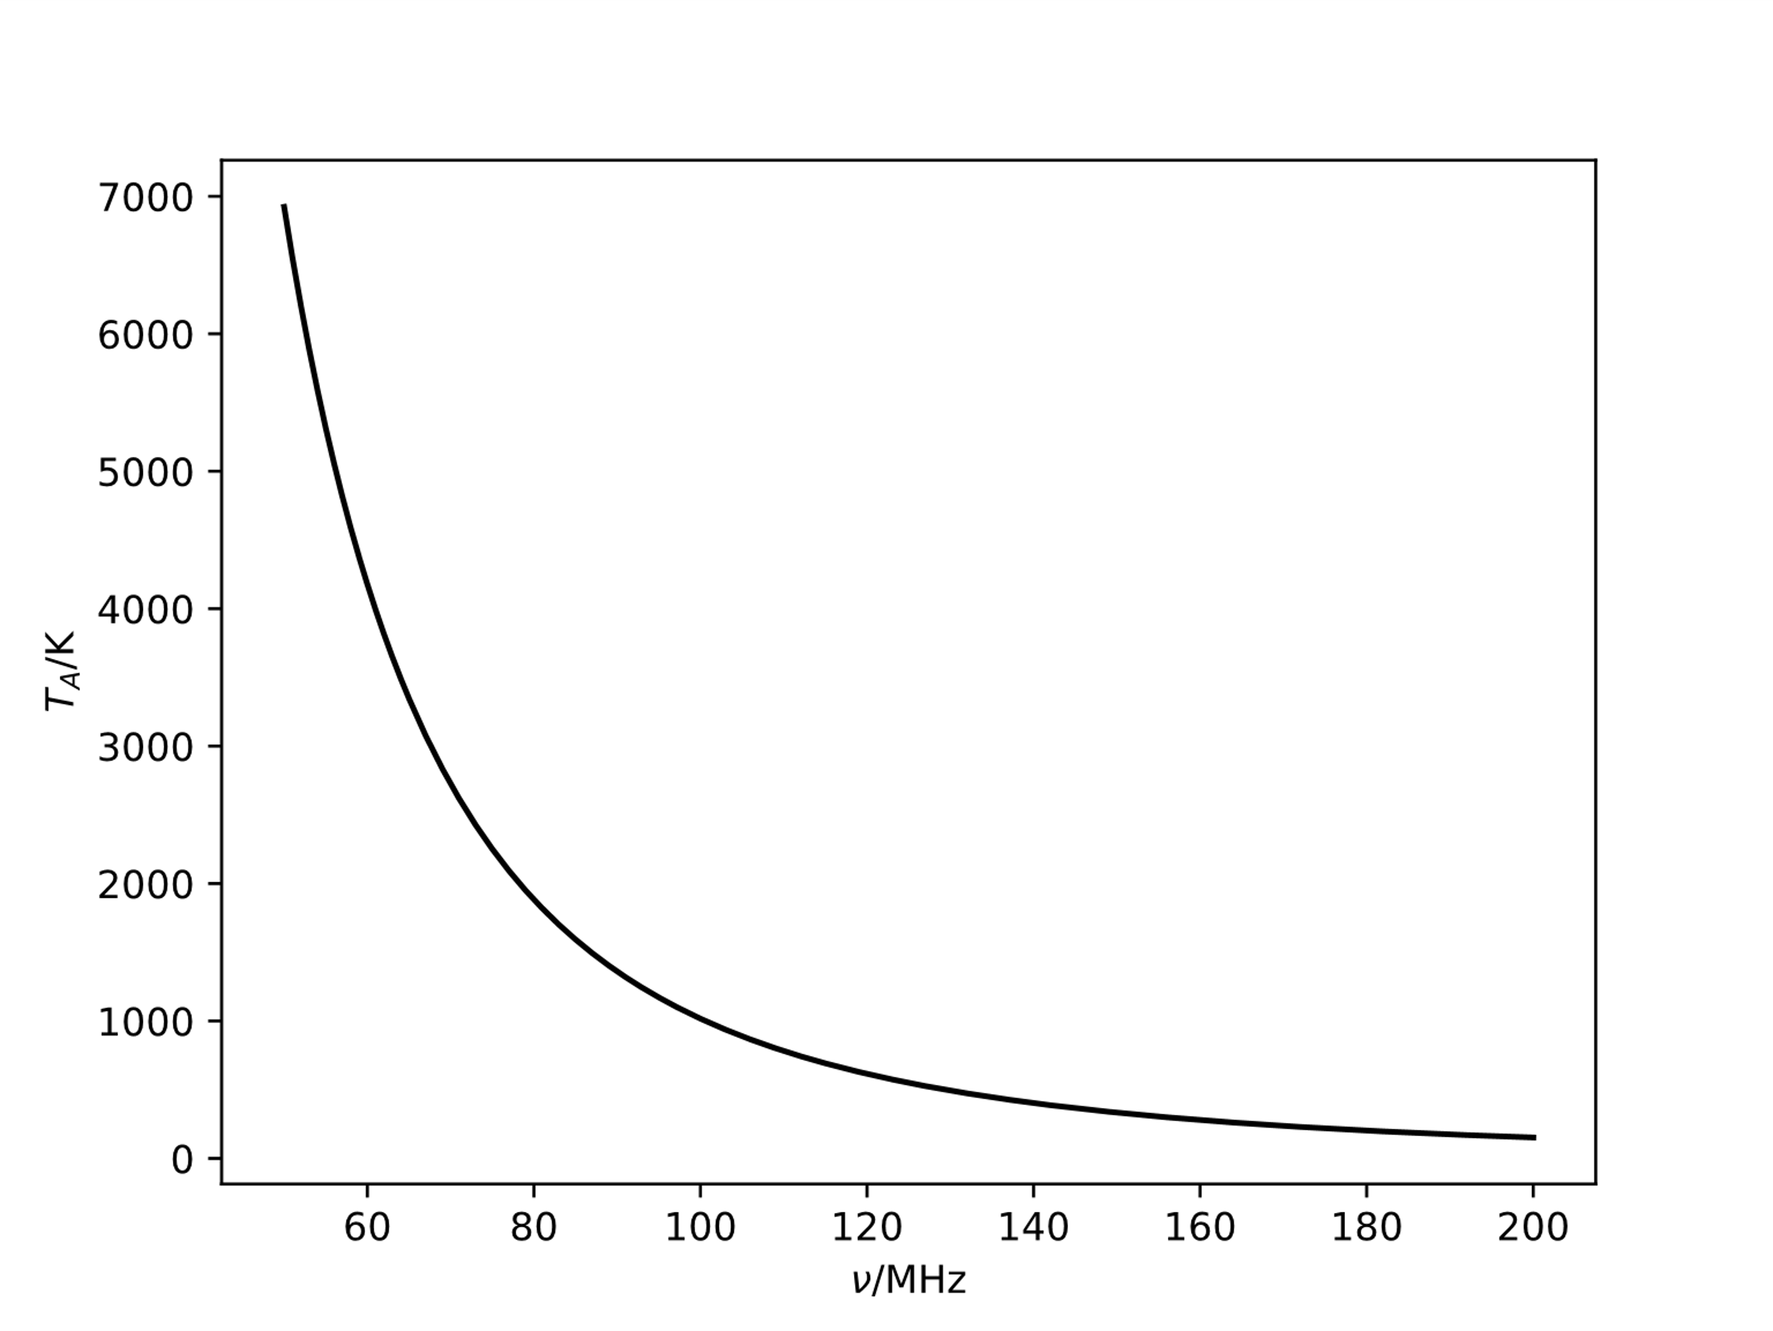

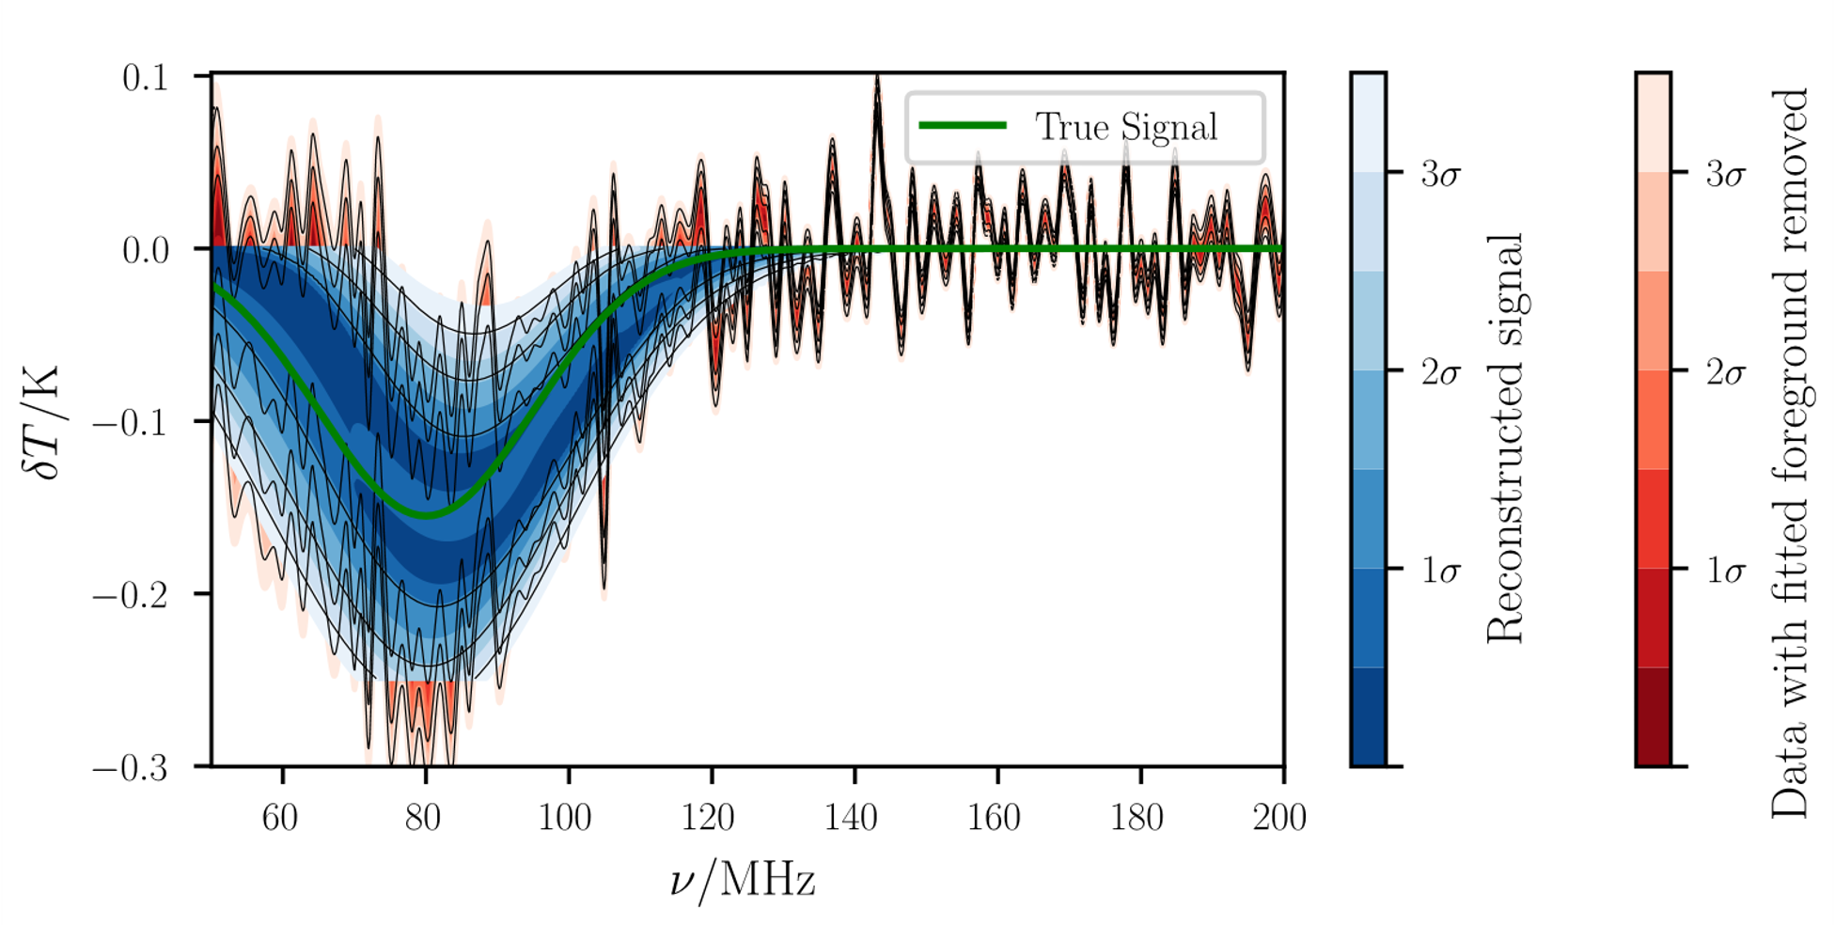
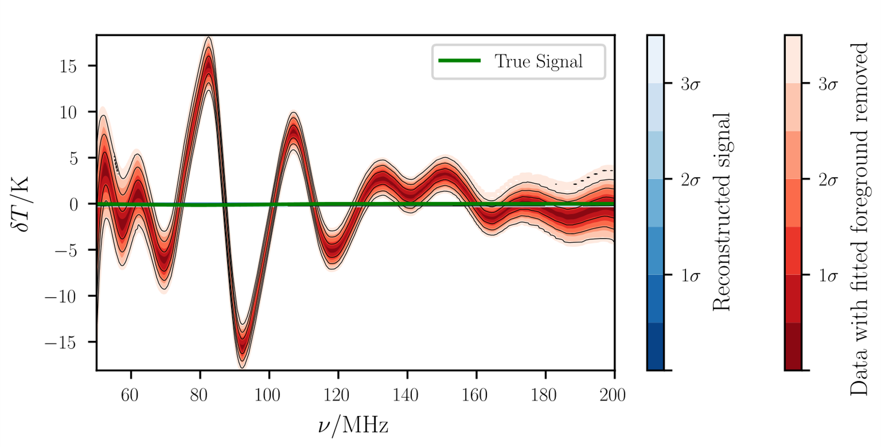
The Issue of Chromaticity
Achromatic antenna
Chromatic antenna

Slide 3
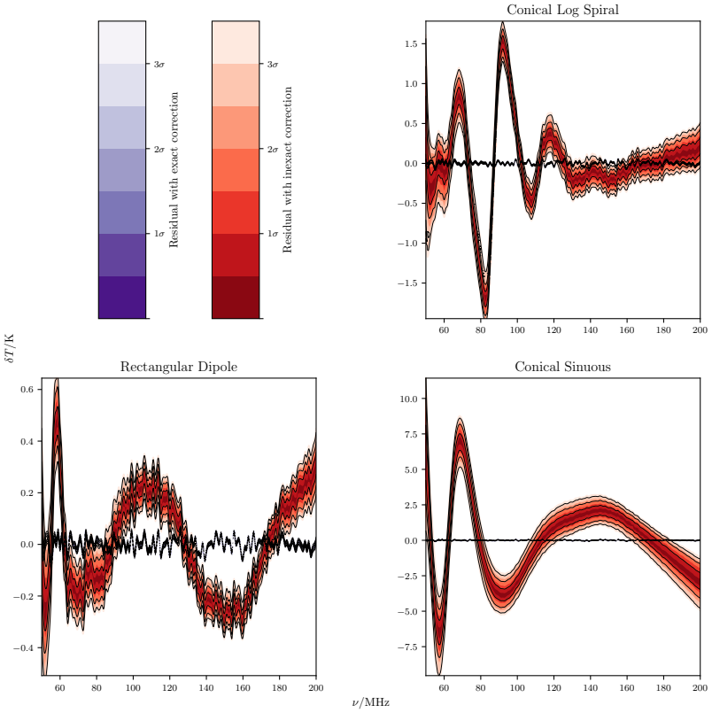
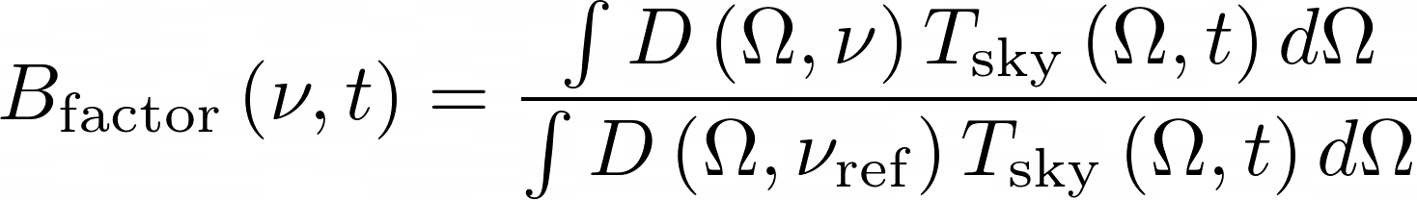
The Issue of Chromaticity
e.g Mozdzen et al. (2019)
Murray et al. (2022)

Slide 4
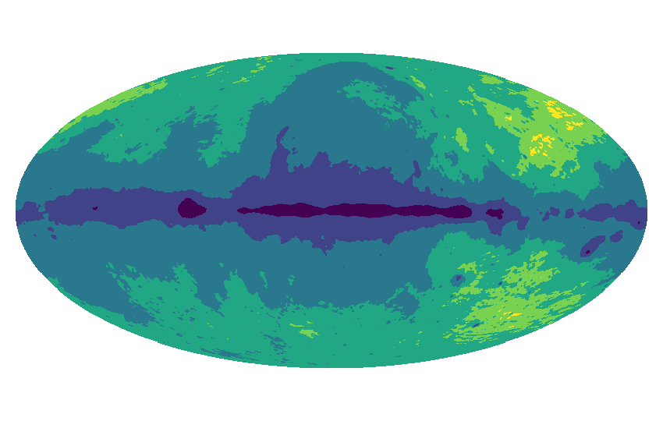
Summary of REACH Pipeline
β₆
β₅
β₄
β₃
β₂
β₁
Anstey et al. 2021

Slide 5
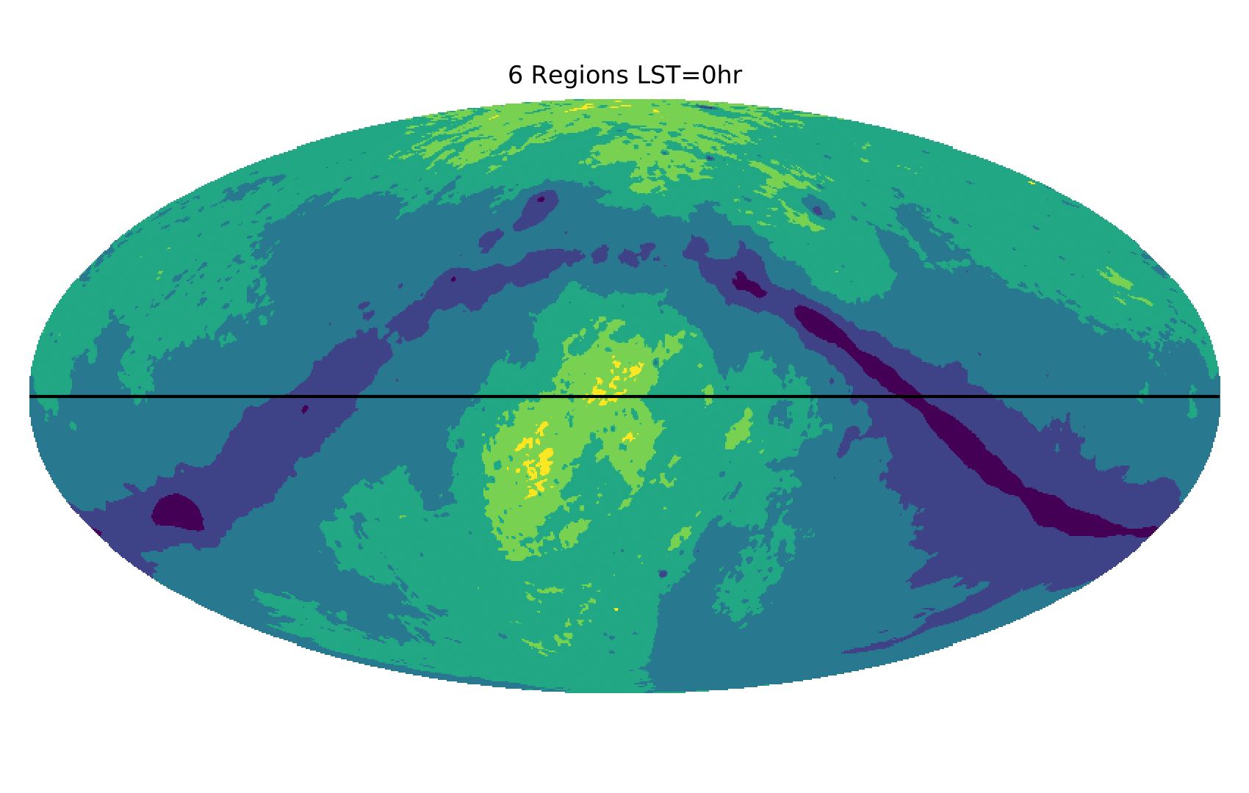
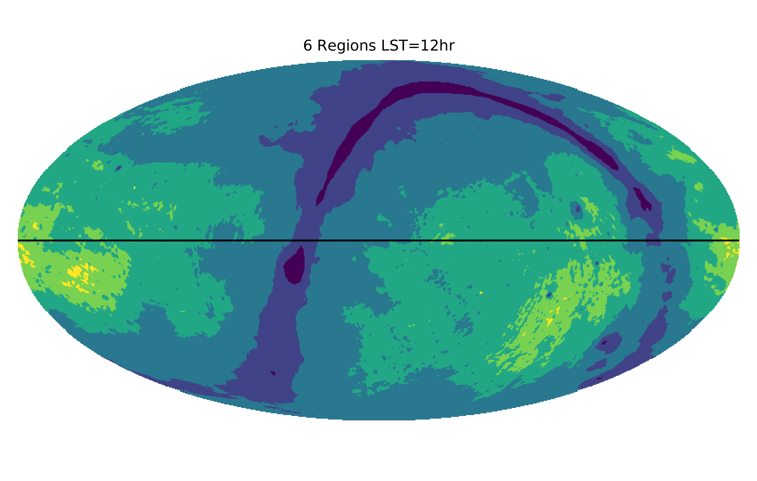
Time-Separated Fitting
Anstey et al. (preprint arXiv:2210.04707)

Slide 6
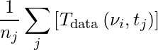

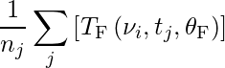
Time-Separated Fitting
(…)
Anstey et al. (preprint arXiv:2210.04707)

Slide 7
Antenna Beam Modelling
The antenna beam pattern may not be known exactly in practice:
Soil permittivity
Horizon effects
Imperfections in construction
Uncertainties in EM solver
Etc.

Slide 8
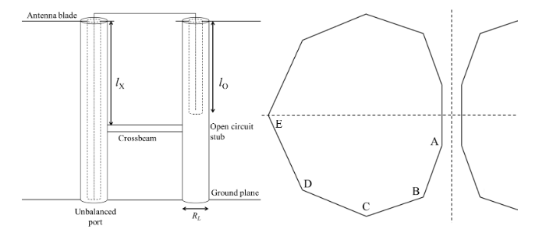
Impact of Uncertainties
 | Ax | Bx | By | Cx | Cy | Dx | Dy | Ex | gap | h | groundplane_size | R_L | l_x | l_o
Beam A | 17.956 | 78.147 | 565.57 | 271.74 | 454.42 | 724.74 | 415.64 | 894.35 | 11.208 | 694.9 | 14196 | 29.694 | 485.65 | 433.16
Beam B | 18 | 79 | 566 | 271 | 454 | 725 | 415 | 895 | 11 | 700 | 14250 | 30 | 486 | 433
Difference | 0.044 | 0.853 | 0.43 | 0.74 | 0.42 | 0.26 | 0.64 | 0.65 | 0.208 | 5.1 | 54 | 0.306 | 0.35 | 0.16
Figure 24 from Cumner et al. 2022

Slide 9
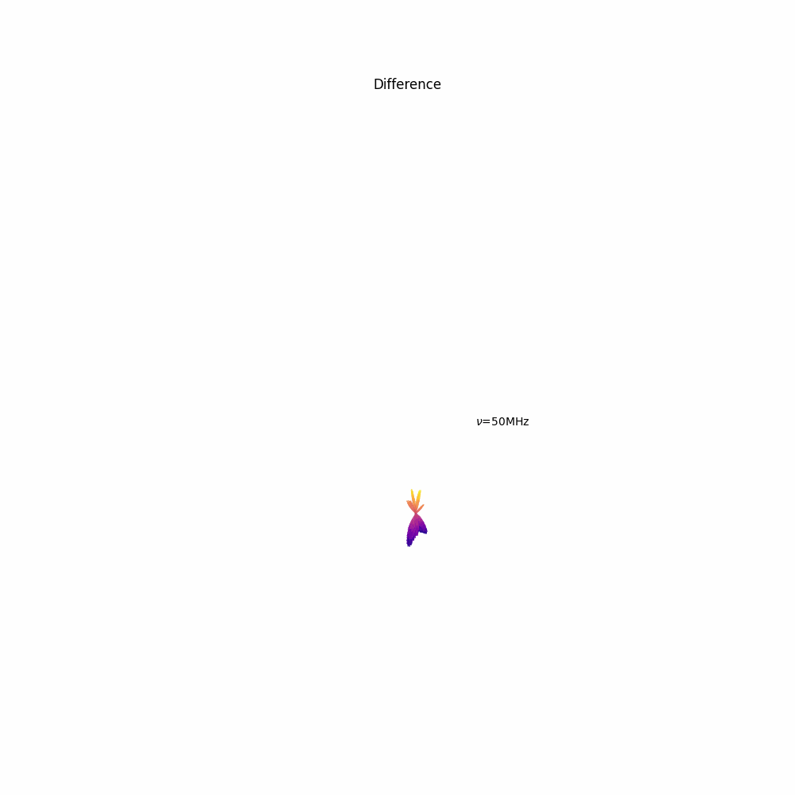
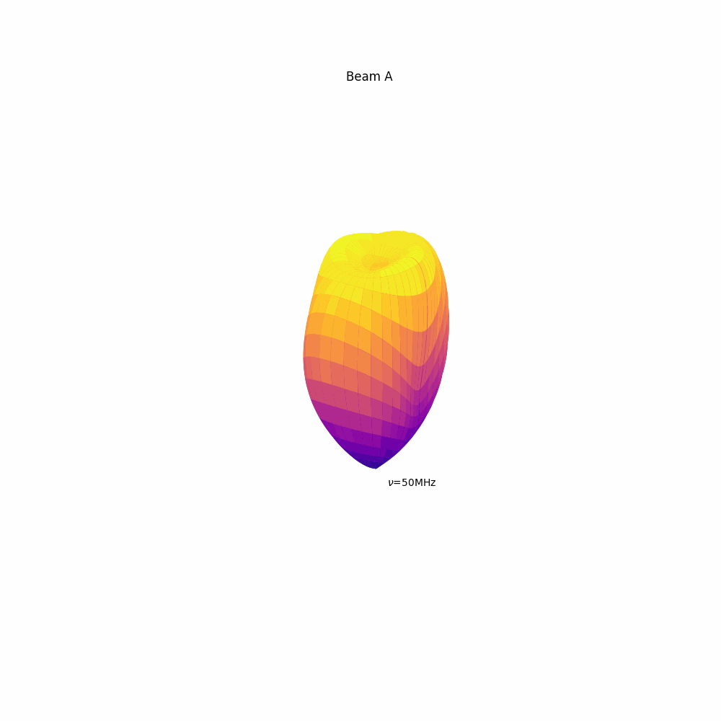
Impact of Uncertainties
Beams simulated by John Cumner

Slide 10
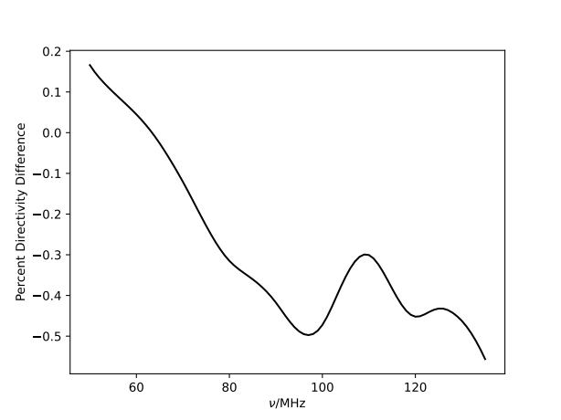
Impact of Uncertainties
Generate a simulated data set using Beam A
Fit for the signal correcting for the chromaticity assuming Beam A
Fit for the signal correcting for the chromaticity assuming Beam B
Foreground known exactly:
GSM base map scaled by -2.55 spectral index

Slide 11
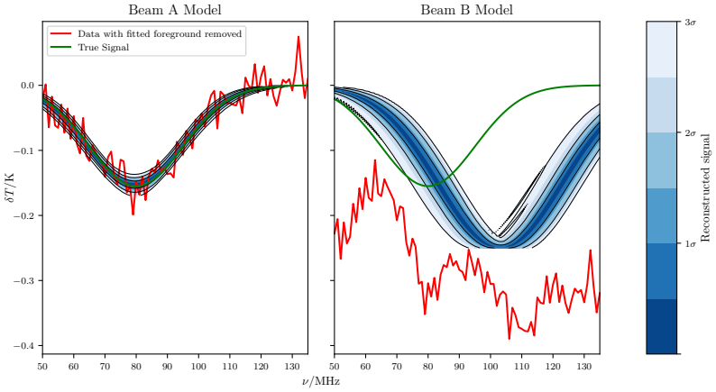
Impact of Uncertainties

Slide 12
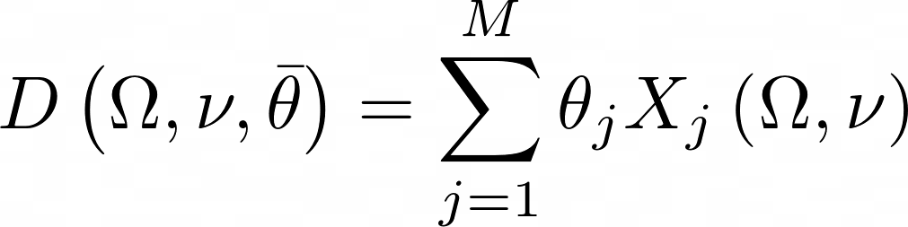
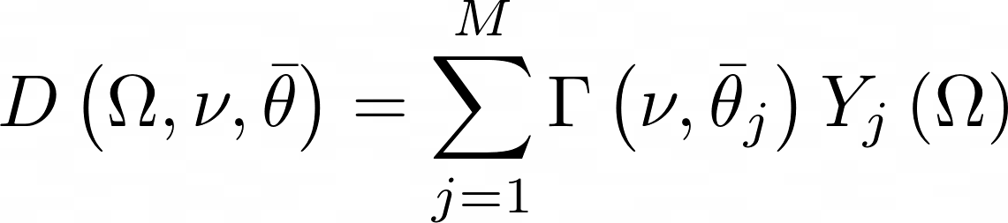
Antenna Beam Modelling

Slide 13
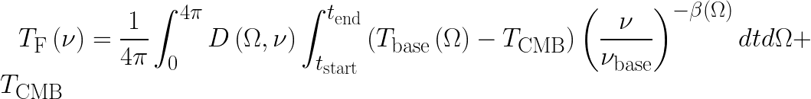
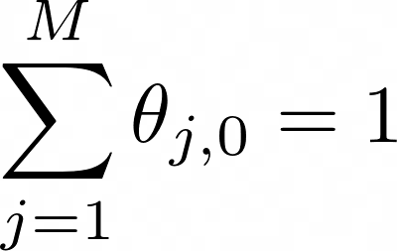
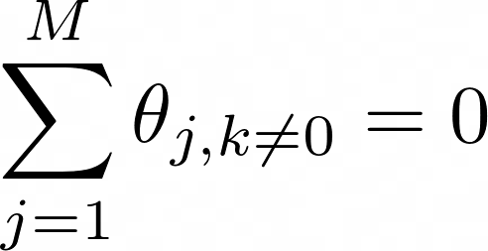
Beam Normalisation
Provided basis functions are all normalised, can use polynomials
0th order coefficients of all basis functions sum to 1
For every other order, coefficients of each basis function must sum to zero

Slide 14
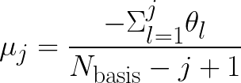
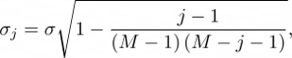
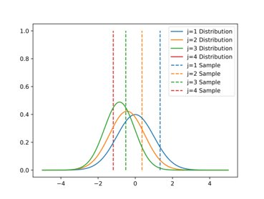
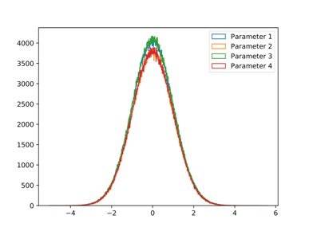
Beam Normalisation

Slide 15
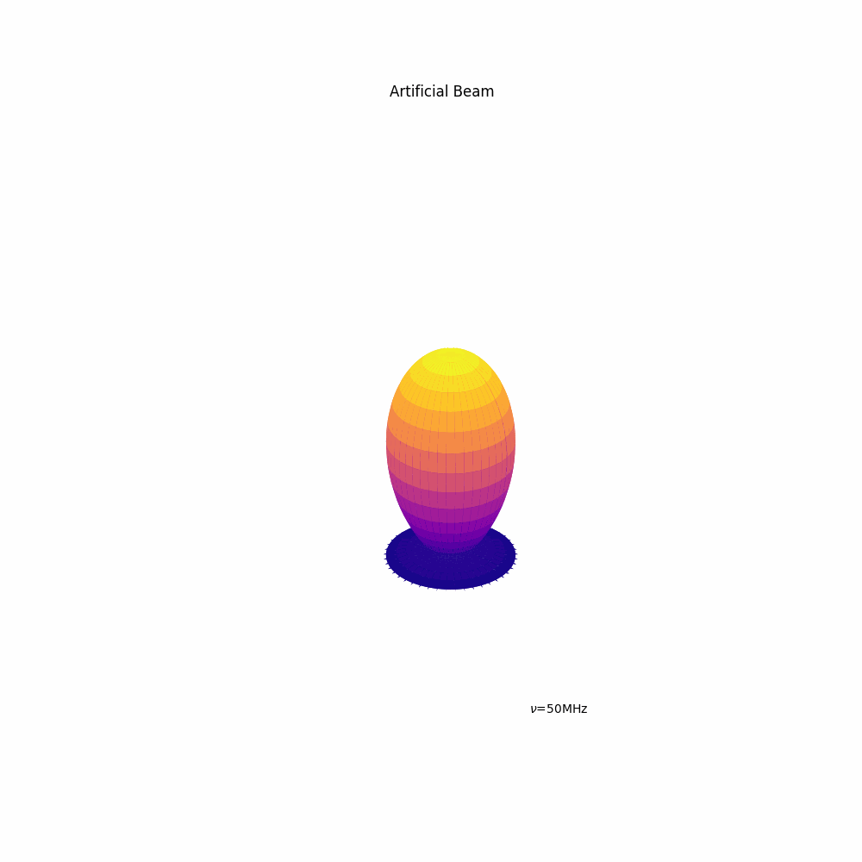
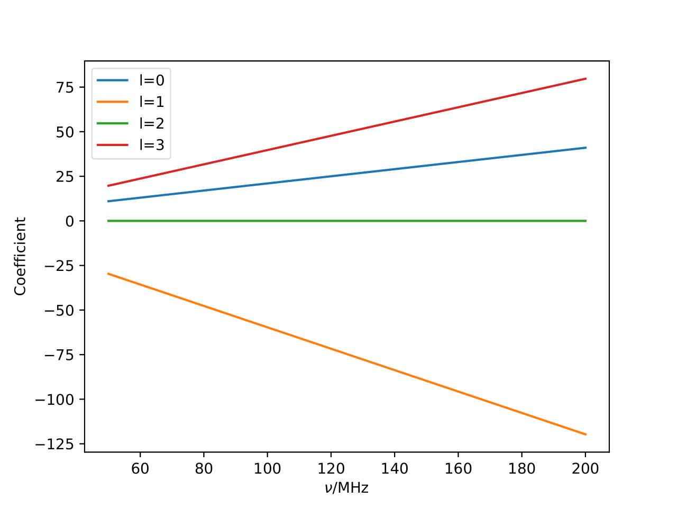
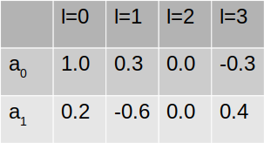
Example Beam

Slide 16
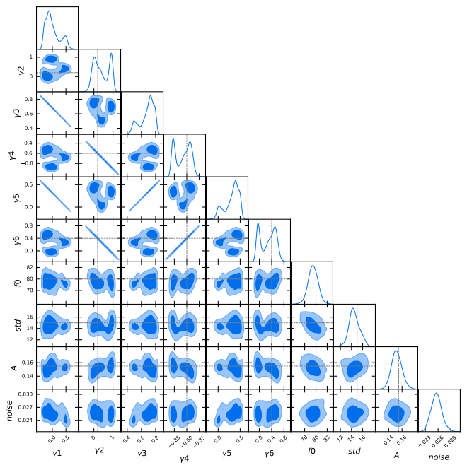
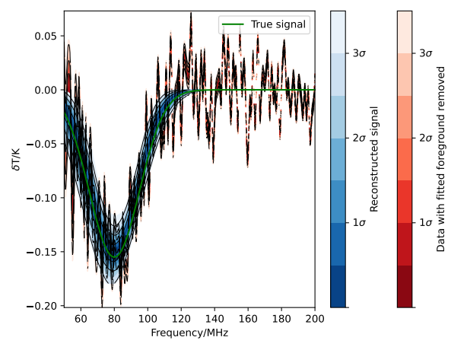
Example Beam Fitting Tests
Foreground model fixed

Slide 17
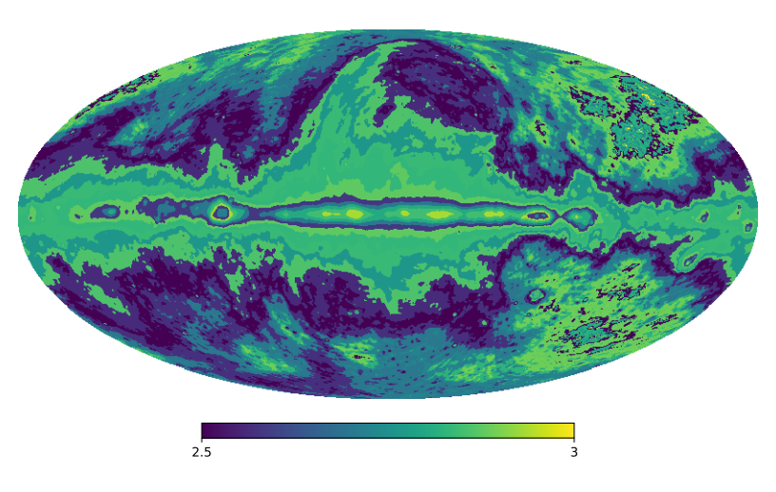
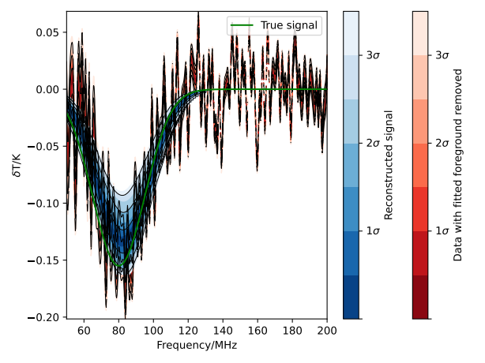
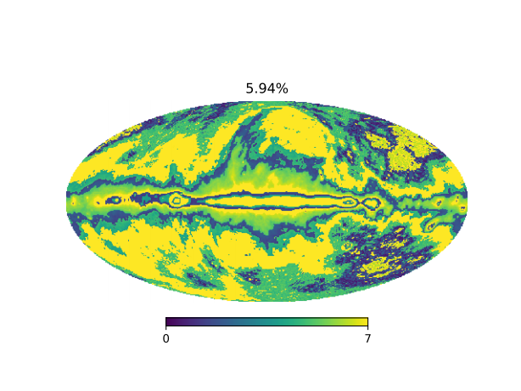
Example Beam Fitting Tests
Fitting foreground together with antenna

Slide 18
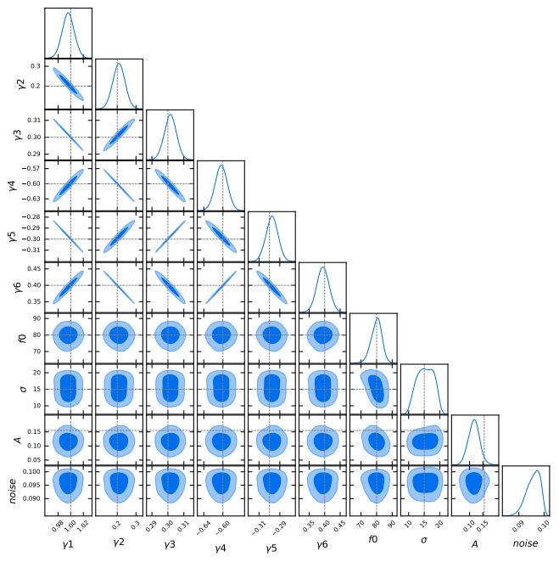
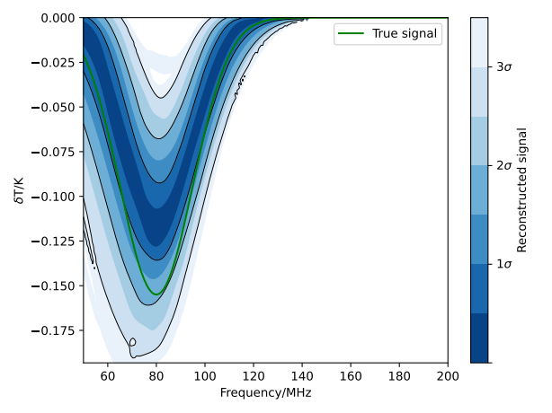
Example Beam Fitting Tests
Foreground model fixed, 2 time bins

Slide 19
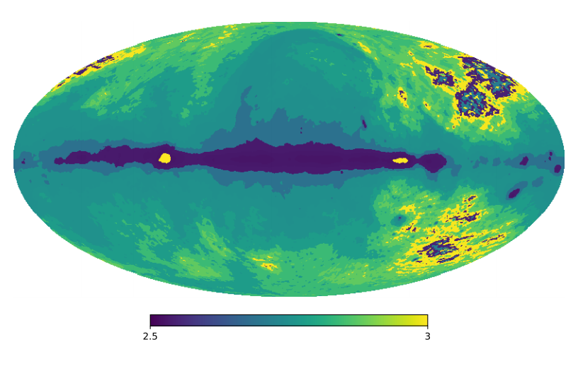
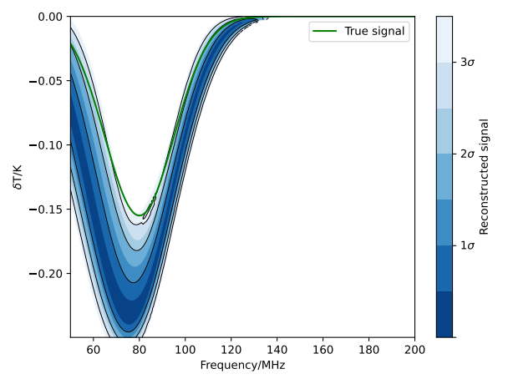
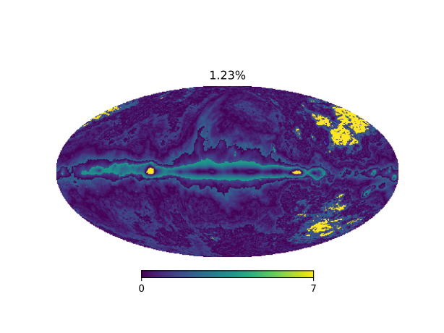
Example Beam Fitting Tests
Fitting foreground together with antenna, 12 time bins

Slide 20
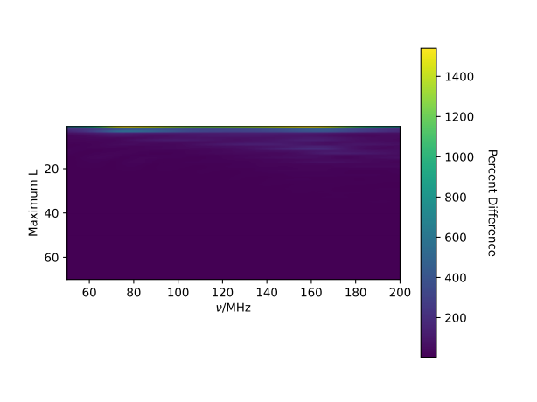
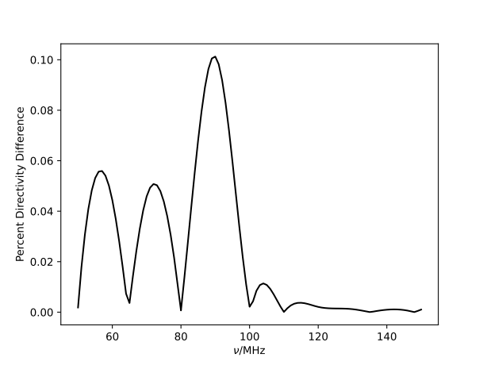
Parameter Numbers
Spherical Harmonic basis functions
Gram-Schmidt basis functions
>2556 basis functions
21 basis functions

Slide 21
Next Steps
Analytical Marginalisation of Linear Parameters
e.g Tauscher et al. (2021), Murray et al. (2022)
Machine Learning

Slide 22
Conclusions
Summarised current state of REACH pipeline
Discussed the impact of beam uncertainties
Showed how antenna beam modelling can be implemented in the REACH pipeline
Discussed challenges with antenna beam modelling and how they can be addressed, in particular:
Beam normalisation
Parameter degeneracies
Antenna EM simulations provided by John Cumner and Quentin Gueuning

